Slide 1
Road Warrior
Event-Driven Trip Management Dashboard
Team - 4
Notes:
Hi, everyone.
We’re Team 4, and this is our solution for Road Warrior — an event-driven trip management dashboard.
Our goal is to help travelers view and manage all of their existing reservations in one place, while supporting scalability, responsiveness, and near real-time updates across web and mobile

Slide 2
Problem, Scope, and Constraints
Notes:
We will start with the problem space, the boundaries of the solution, and the core constraints that shaped our architecture

Slide 3
What Problem Are We Solving?
Unified dashboard
View and manage all existing travel reservations in one place across web and mobile
Reservation ingestion
Auto load reservations from agency airline, hotel, and car rental systems, with manual fallback entry
Trip management
Group reservations into logical trips with search/filter support and archive completed trips
Real-time experience
Provide live dashboard updates, notifications, and social trip sharing
Business visibility
Highlight preferred partner vendors while keeping new booking out of scope
Notes:
So, What Problem are we solving?
At its core, travelers need a single unified dashboard to manage all existing travel reservations across web and mobile. The system must ingest reservation data from the agency’s airline, hotel, and car-rental interface systems,
while still allowing manual reservation entry as a fallback.
Beyond simply listing reservations, the platform must intelligently group them into trips, archive completed trips,
provide live updates and notifications, support search and filtering, and even enable trip sharing.
At the same time, booking new travel remains explicitly out of scope

Slide 4
Quality Drivers
Scalability Support growth from 10k to 100k active users
Responsiveness Rich UI across web and mobile with fast interactions
Elasticity Absorb seasonal traffic spikes efficiently
Availability Travelers must access current trip details globally
Data freshness Updates such as delays or cancellations should appear quickly
Notes:
The design was driven primarily by quality attributes (NFRs) rather than only functional features.
The first driver is scalability. The problem statement starts at more than ten thousand users and expects growth toward one hundred thousand active users, with seasonal peaks reaching several thousand concurrent users.
The second driver is responsiveness which implies fast and fluid user interactions on both web and mobile.
The third driver is elasticity. Travel demand is seasonal, so the system must scale up during peaks and scale down efficiently during off-peak periods.
The fourth driver is availability. Travelers rely on the platform while in transit, so the system must remain accessible and dependable across time zones.
Finally, data freshness is critical. Updates such as delays or cancellations need to appear quickly enough that users trust the dashboard as the current source of truth.

Slide 5
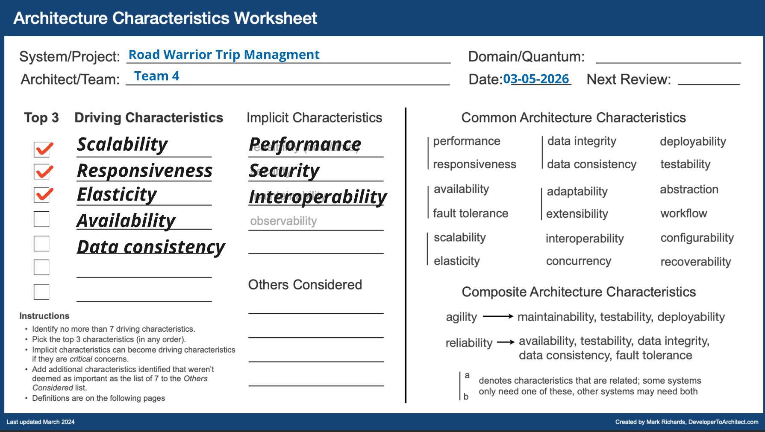
Notes:
This slide summarizes the architecture characteristics that most strongly influenced our decisions.
The top-3 strongest drivers are scalability, responsiveness, elasticity
with performance, security, and interoperability acting as important implicit supporting characteristics.

Slide 6
Assumptions
Agency systems can publish events or expose efficient delta APIs
Authentication is handled by the agency identity provider
Trip grouping uses dates, locations, and travel sequence heuristics
Initial release focuses on English and UTC-based handling
Favored vendor status is provided by the agency interface layer
Notes:
We made a few key assumptions to keep the design realistic and focused. First, we assumed that agency systems can either publish events or expose efficient delta APIs. Second, we assumed authentication is handled by the agency identity provider. We also assumed trip grouping can be based on dates, locations, and travel-sequence heuristics
Initial release on English and then support Internationalization

Slide 7
Solution Strategy
Notes:
With that context in place, I’ll move into the solution strategy; how we translated these requirements and drivers into architectural decisions

Slide 8
Chosen Architecture Style and Rationale
Event-Driven Microservices
Allows independent scaling and asynchronous processing for reservations, notifications, and trip computations.
Modular Backend-For-Frontend
Simplifies client integration by providing a cohesive API surface, centralizing authentication and caching.
Scalability and Simplicity Balance
Combines microservices scalability with operational simplicity through streamlined client interactions.
Considered Alternatives
Synchronous monolith and serverless approaches were rejected due to scalability and predictability issues.
Notes:
We chose an event-driven microservices architecture with a modular BFF layer. This allows reservation ingestion, trip processing, notifications, and sharing to scale independently while handling updates asynchronously. It supports near real-time changes, absorbs traffic spikes efficiently, and protects user-facing APIs through messaging-based buffering. The BFF provides a single API surface for web and mobile, simplifying integration while centralizing authentication, caching, and response aggregation. Overall, this approach balances scalability, responsiveness, and operational simplicity better than a synchronous monolith or a fully serverless design

Slide 9
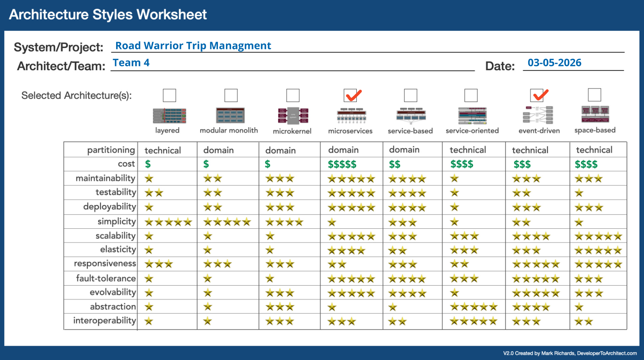
Notes:
This worksheet reflects the same conclusion visually: event-driven microservices
scored best against the architectural drivers
that mattered most to us — especially scalability, elasticity, and responsiveness

Slide 10
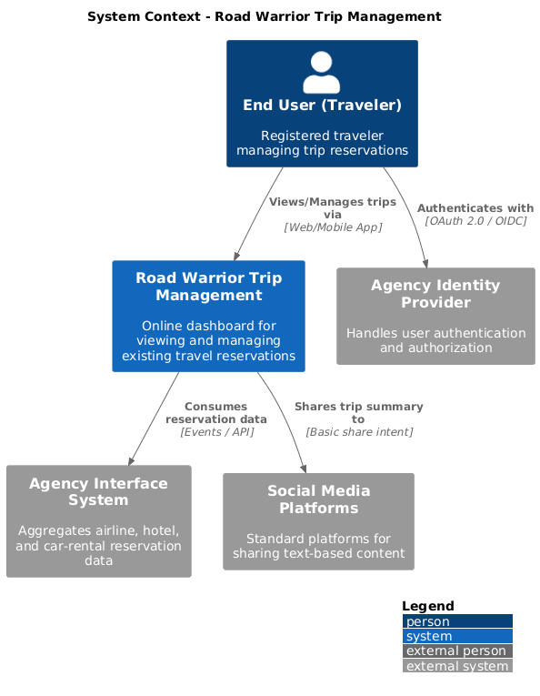
Notes:
Finally, this context diagram shows the system boundary and its key interactions.
The central Road Warrior Trip Management system serves the end user,
integrates with the agency interface system for reservation data,
relies on the agency identity provider for authentication,
and connects outward to social media platforms for trip sharing

Slide 11
Logical and Physical Architecture
Notes:
Let's look into Logical & Physical Architecture.

Slide 12
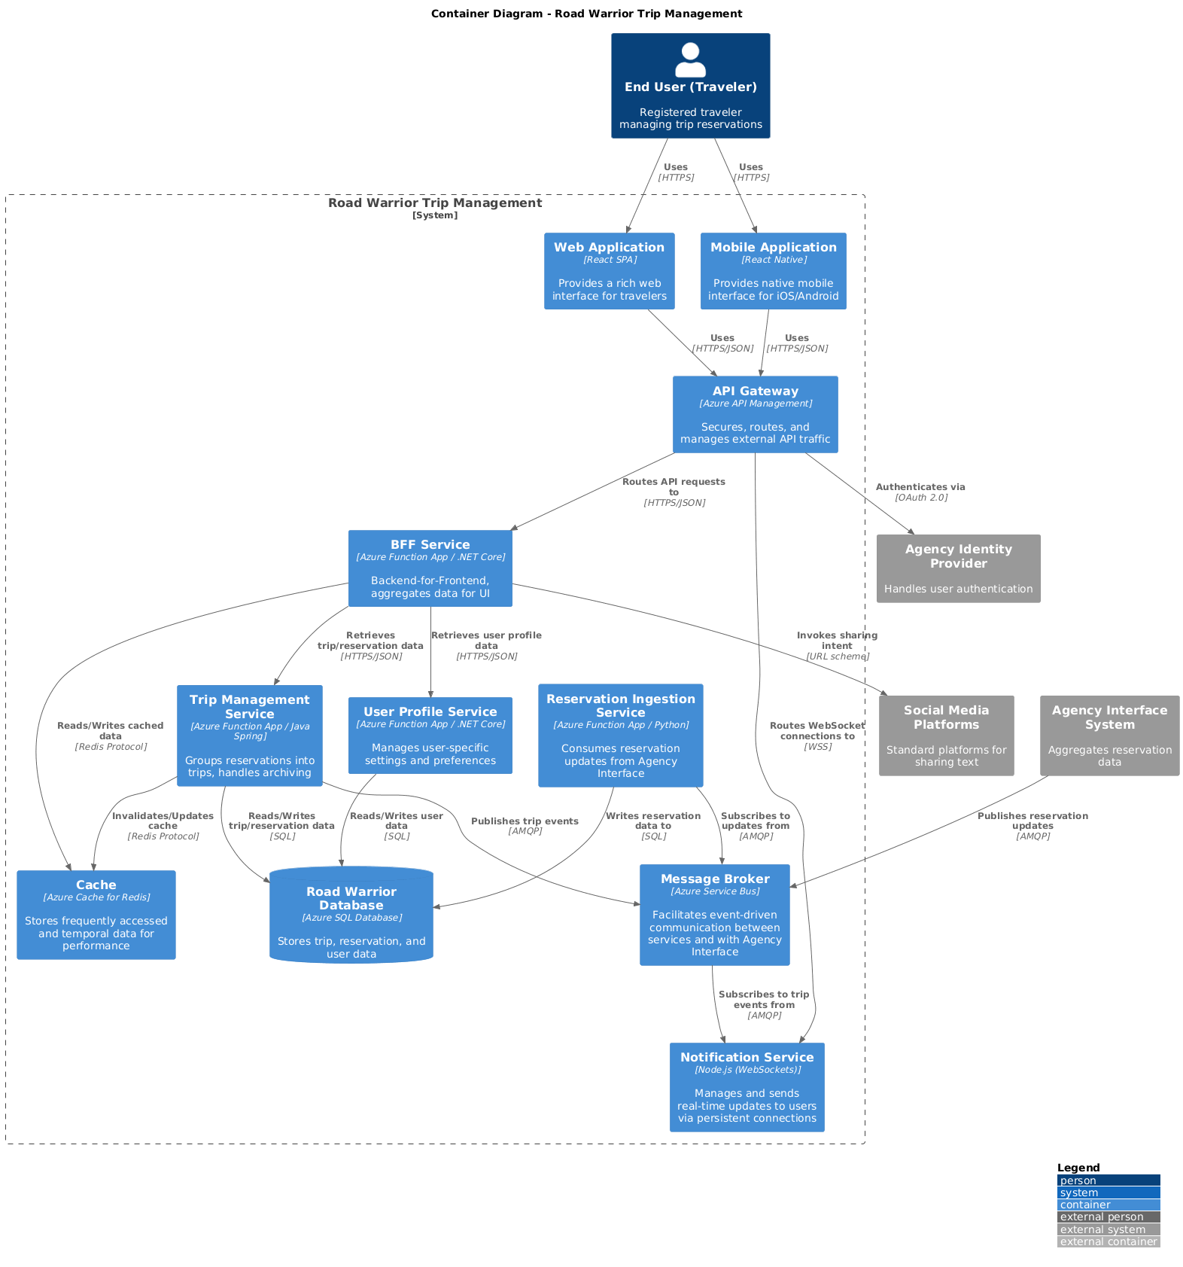
Notes:
In this architecture, web and mobile clients connect via API Management and a BFF layer, ensuring clean APIs, security, and traffic control.
The Reservation Ingestion Service processes and normalizes updates from external systems, while the Trip Management Service organizes reservations into meaningful trips.
The Notification Service pushes real-time updates like delays or cancellations to users.
For data, Azure SQL is the primary store for consistency, Redis improves performance with caching, and Service Bus enables event-driven communication between services.”

Slide 13
Logical Architecture
Web and mobile clients consume APIs through API Management and BFF
Reservation Ingestion Service processes agency-system updates
Trip Management Service groups reservations into trips
Notification Service pushes critical updates to clients
Azure SQL stores core data, Redis improves read performance, Service Bus carries events
Notes:
A microservices architecture where web and mobile clients access the system via an API Gateway and BFF, with core services, SQL + Redis for data, event-driven messaging, and real-time updates via WebSockets, integrated with external systems.

Slide 14
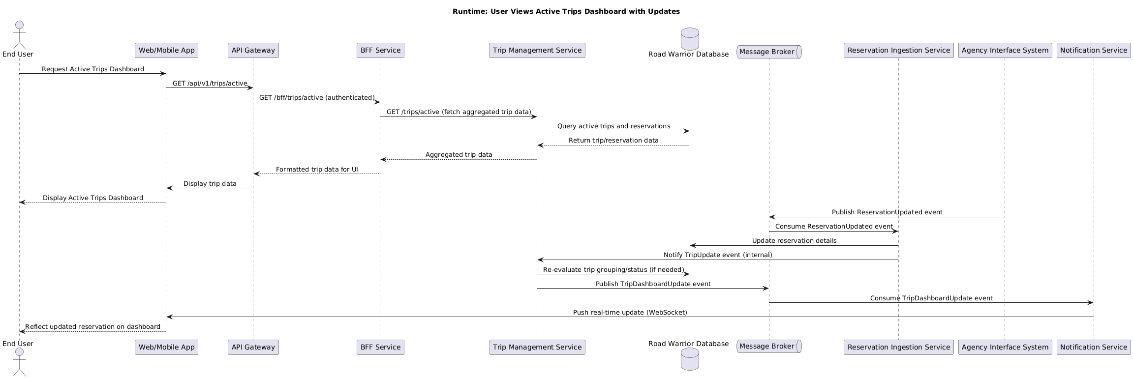
Notes:
This slide shows how updates reach the traveler in near real-time.
An agency system publishes a reservation update, which is consumed by the Reservation Ingestion Service to validate and update the database.
If needed, the Trip Management Service recomputes trip grouping.
Finally, the Notification Service pushes the update to users via WebSockets or SSE.
The key idea is an event-driven, eventually consistent design that improves scalability and resilience while keeping the dashboard up to date.

Slide 15
Runtime Flow
Agency system publishes a reservation update event
Reservation Ingestion Service validates and persists the change
Trip Management updates trip grouping if needed
Notification Service pushes delay or cancellation changes to active clients
Dashboard reflects the latest state without user polling
Notes:
The system serves and updates the Active Trips dashboard. User requests go through the API Gateway and BFF to fetch aggregated trip data from backend services. Meanwhile, reservation updates are processed asynchronously via a message broker, and real-time changes are pushed to the user through WebSockets, keeping the dashboard always up to date.

Slide 16
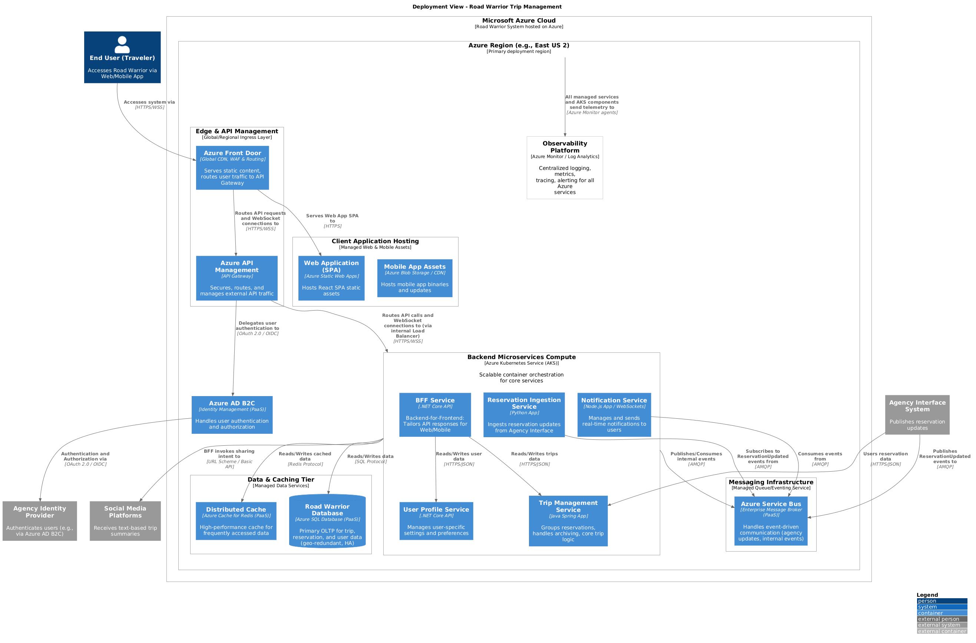
Notes:
From a deployment perspective, the system is cloud-native and built on managed Azure services.
Stateless services run on AKS for horizontal scalability, while Azure SQL, Redis, and Service Bus handle data, caching, and messaging.
At the edge, Front Door and CDN improve performance and global access.
Overall, this setup ensures scalability, high availability, and low operational overhead, with the tradeoff of some vendor dependency.

Slide 17
Deployment Posture
Cloud-native deployment on Azure managed services
AKS hosts stateless backend services with horizontal auto-scaling
Azure SQL, Redis, and Service Bus provide managed data and messaging capabilities
Front Door and CDN improve global performance and edge protection
Observability supports distributed tracing, metrics, and alerting

Slide 18
Decisions, Risks, and Concerns
Notes:
Key Architecture Decision Records and Data Strategy, Risk Mitigation, NFR Coverage, and Future Evolution

Slide 19
Key Architecture Decision Records and Data Strategy
Microservices Architecture (ADR-1)
For independent scaling, fault isolation, and maintainability; tradeoff is distributed-system and operational complexity.
Event-Driven Data Ingestion (ADR-2 and ADR3)
Data ingestion uses event-driven approach for near real-time updates, fallback polling, retries, and failure handling via queues.
Managed Cloud Deployment (ADR-4)
To improve elasticity, availability, and operational efficiency; tradeoff is cloud cost control and vendor dependence.
Primary Data Store Choices (ADR-5)
Azure SQL is the primary operational store because trips, reservations, and user data are strongly relational, Redis improves read performance and Service Bus carries events.
Automated Trip Grouping Logic (ADR-6)
Reservations are grouped automatically by deterministic date and location rules while allowing manual user overrides for flexibility.
Notes:
Here, I want to quickly walk through the key decisions and why they made sense for this problem.
Starting with ADR-1, we went with microservices because different parts of this system behave very differently. Reservation ingestion, trip grouping, notifications, and client APIs will not scale in the same way, so separating them gives us better control.
Then ADR-2 and ADR-3 handle the update flow. Since the dashboard should not become stale, we chose asynchronous event-driven ingestion and push-based updates to the client. That way, if there is a delay or cancellation, we can reflect it quickly without depending only on polling from the UI side.
ADR-4 is about deployment. We chose managed Azure services mainly to reduce operational overhead and to support elasticity and availability from the beginning.
ADR-5 is the data strategy. We kept Azure SQL as the primary operational store because trips, reservations, and user information are closely related and need consistent querying. Redis is there to improve read performance, and Service Bus is there to move events reliably between services.
Finally, ADR-6 covers trip grouping. The problem statement clearly leans toward automatic grouping, so we kept that as the default. At the same time, we allowed user override because travel patterns are not always clean, and rule-based grouping can get some cases wrong.
So overall, the decisions are quite straightforward: keep the system responsive, keep it scalable, and make sure it stays practical for a trip-management use case rather than over-designing it like a booking platform.

Slide 20
Key Risks and Concerns
Integration Dependency
The platform depends on the agency integration hub for reservation updates; mitigated through asynchronous messaging, retries, and polling fallback where needed.
Scalability and Burst
Seasonal demand spikes can overload synchronous paths, mitigated through stateless services, horizontal scaling, asynchronous workers, and queue-based buffering.
Data Consistency
Duplicate or delayed events can create inconsistent trip views, mitigated through idempotent processing, deduplication keys, and reconciliation logic.
Privacy and Security
Travel data is sensitive and internationally visible, mitigated through strong authentication, encryption, auditability, and least-privilege access.
Operational Visibility
Distributed systems are harder to troubleshoot, mitigated through tracing, metrics, logging, and proactive alerting.
Notes:
This slide is mainly about the hard parts we expected upfront and how we planned for them.
The first concern is dependency on the agency integration hub. Since we are not integrating directly with airlines or hotels, if that upstream layer is slow or unavailable, our dashboard can get affected. To reduce that risk, the design uses asynchronous messaging, retries, and polling fallback where needed.
The second concern is around peak season traffic. As usage can go up sharply during travel seasons, so we did not want everything sitting on one synchronous path. Stateless services, horizontal scaling, background processing, and queue buffering help absorb those bursts..
The third concern is consistency. In an event-driven setup, duplicate or delayed messages are always possible. So the mitigation here is idempotent processing, deduplication using reservation identifiers, and reconciliation where needed. That is also important if we want to stay within the expected eventual consistency window.
The fourth concern is privacy and security. We are dealing with travel data, user profiles, and reservation details, so we need strong authentication, encryption, careful handling of personal data, and auditability for sensitive operations.
The fifth concern is observability. In distributed services, troubleshooting becomes much harder unless tracing, metrics, logs, and alerts are already part of the design. So we treated observability as a built-in capability.
So the idea here was not to remove all risk, because that is not realistic. The goal was to identify the main risks early and make sure the architecture has a clear response for each of them.

Slide 21
Thank You
Notes:
Thank you. We will be happy to take any questions.

Slide 22
Risk Mitigation, NFR Coverage, and Future Evolution
Risk Mitigation Strategies
Key risks are addressed through asynchronous messaging, retries, and fallback mechanisms to maintain system functionality.
Non-Functional Requirements Coverage
Availability uses multi-zone managed services; performance is enhanced via caching and indexed queries.
Data Consistency and Privacy
Data duplication is reduced by idempotent processing; privacy ensured with encryption and audit logging.
Future Evolution Path
Architecture supports scaling with read replicas, multi-region deployments, and advanced machine learning features.
Notes:
The Road Warrior architecture explicitly addresses key risks and maps them to mitigation strategies. Dependency on the agency integration hub is mitigated through asynchronous messaging, retries, and a polling fallback, ensuring the dashboard remains functional even during upstream issues. Seasonal traffic spikes are handled through horizontal scaling of stateless services and background workers, with queue depth monitoring and autoscaling policies to absorb bursts. Data duplication and inconsistency risks are reduced through idempotent processing and deduplication based on vendor and confirmation identifiers. International privacy and compliance risks are mitigated through encryption, audit logging, and careful handling of personally identifiable information. From a non-functional perspective, availability is supported by multi–availability zone managed services, while performance benefits from caching and indexed queries. Observability is built in through distributed tracing and metrics, enabling proactive issue detection. Looking ahead, the architecture provides a clear evolution path. High-traffic services such as reservation ingestion can be further optimized or isolated if needed. Read replicas or multi-region deployments can be introduced to reduce latency and improve disaster recovery. More advanced trip grouping techniques, such as machine learning, can be layered on once the rule-based system is proven. This forward-looking design ensures Road Warrior can grow and adapt as user needs and scale increase.

Slide 23
Physical Deployment Architecture on Azure
Secure Traffic Entry
Azure Front Door and web application firewall provide global entry points with caching and attack protection.
Core Application Hosting
Core app components run in virtual networks using Azure App Service, Container Apps, and AKS for microservices.
Messaging and Background Processing
Azure Service Bus and Event Hubs enable event-driven communication, with Azure Functions for background tasks.
Data Storage and Caching
Data stored in Cosmos DB and SQL Database ensures high availability, supported by Redis cache and Blob Storage.
Notes:
The physical deployment architecture maps the logical components of Road Warrior onto concrete Azure infrastructure in a way that satisfies availability, performance, and security requirements. Client traffic enters through Azure Front Door and a web application firewall, providing global entry points, caching, and protection against common attacks. Azure API Management acts as the primary gateway into the system, enforcing policies and routing requests to the backend. The core application components run within a virtual network using a combination of Azure App Service or Container Apps for the BFF and AKS or Container Apps for the microservices. This private data plane isolates sensitive services and data from direct internet exposure. Azure Service Bus or Event Hubs provide the messaging backbone for event-driven communication, while Azure Functions or containerized workers process ingestion and background tasks. Data is stored in managed services: Azure Cosmos DB for user-related data and Azure SQL Database for trips and reservations, both configured for high availability. Azure Cache for Redis accelerates read paths, and Azure Blob Storage supports archival and export needs. Azure SignalR Service resides in the public subnet to manage persistent client connections for real-time updates. Cross-cutting concerns such as secrets management and observability are handled by Azure Key Vault and Azure Monitor with Application Insights. This deployment leverages managed services to reduce operational burden while delivering the required resilience and scalability.

Slide 24
Logical Architecture
API Management Layer
The API management layer routes requests and enforces rate limiting and authentication for client applications.
Core Domain Microservices
Microservices like User, Trips, Reservation, Sharing, and Notification own their business logic and data independently.
Event-Driven Messaging Backbone
Services communicate asynchronously through a central messaging backbone enabling event publication and consumption.
Caching and Real-Time Updates
Caching accelerates dashboard queries while real-time messaging pushes updates to connected clients.
Notes:
At the edge, web and mobile clients connect through API Management and the BFF layer. That gives us a clean boundary for client-specific APIs, security enforcement, and traffic management.
Behind that, the Reservation Ingestion Service handles updates coming from agency systems. Its job is to validate and normalize incoming events and persist reservation changes into the system.
The Trip Management Service applies grouping logic to organize reservations into meaningful trips based on timing, geography, and travel sequence.
The Notification Service is responsible for pushing important changes, such as delays or cancellations, back to connected clients.
For persistence, Azure SQL is the primary operational store because the data model is naturally relational and benefits from strong consistency

Slide 25
Functional and Non-Functional Requirements Driving Design
Core Functional Requirements
Defines essential system tasks including reservation ingestion, manual fallback, trip grouping, and lifecycle handling.
User Engagement Features
Includes search, filtering, social sharing, and notifications to enhance usability and provide real-time updates.
Non-Functional Requirements
Specifies system quality aspects like availability, performance, scalability, data freshness, security, and observability.
Notes:
The functional requirements of Road Warrior define what the system must do from a user’s perspective, while the non-functional requirements describe how well it must do it. Core functional requirements include automatic ingestion of reservations from agency systems, manual reservation management as a fallback, automatic grouping of reservations into trips, and lifecycle handling that moves completed trips into a ‘Past Trips’ archive. Additional capabilities such as search, filtering, and social sharing improve usability and engagement, while optional notifications for delays or cancellations add tangible user value. Equally important are the non-functional requirements, which strongly shape the architecture. Availability is targeted at 99.9% monthly, implying the use of multi–availability zone managed services and resilient communication patterns. Performance goals specify P95 read latencies under 200 milliseconds and write latencies under 500 milliseconds, reflecting the read-heavy nature of dashboard interactions. Scalability requirements call for handling thousands of concurrent users during peak seasons without degradation. Data freshness requirements emphasize near real-time updates, though bounded staleness is acceptable. Security and privacy requirements mandate modern authentication, encryption in transit and at rest, auditability, and minimization of personally identifiable information. Finally, observability requirements demand end-to-end tracing, metrics, and alerting to ensure the system can be operated confidently at scale. Together, these requirements form the foundation for all subsequent architectural decisions.

Slide 26
Scope Boundaries, Assumptions, and External Dependencies
System Integration Boundaries
The system integrates only with existing travel agency interfaces, avoiding direct integration with numerous vendors to reduce complexity.
Data Freshness Assumptions
Data is kept updated via event-driven feeds or periodic polling without strict real-time requirements, balancing freshness with reliability.
User Interaction and Trip Grouping
Trip grouping is system-driven with heuristic rules and allows user overrides; manual reservation entry supports resilience and usability.
Security and External Dependencies
The system operates within a trusted agency infrastructure, simplifying security and avoiding complex social media integration flows.
Notes:
Defining clear scope boundaries and assumptions is critical to avoiding unnecessary complexity in the Road Warrior architecture. The most important boundary is that the system integrates only with the travel agency’s existing airline, hotel, and car rental interface systems, which act as facades over many external vendors. Direct integration with hundreds of individual airlines or hotels is explicitly out of scope, and this assumption significantly reduces integration risk and operational overhead. Another key assumption concerns data freshness: reservations are expected to be automatically loaded and kept up to date, but strict real-time guarantees are not required. The architecture therefore assumes an event-driven feed from the agency systems where available, with a well-documented fallback to periodic polling when events are not provided. Manual reservation entry is supported as a resilience and usability feature, allowing users to input the same data model that would otherwise be received automatically. Trip grouping is assumed to be primarily system-driven, based on reasonable heuristics such as date proximity and location continuity, with optional user overrides for edge cases. Social media sharing is intentionally scoped to high-level, textual summaries or links, avoiding deeper integrations that would require complex authorization flows. Finally, the system is assumed to operate within a trusted agency infrastructure boundary, simplifying network security and identity integration. These assumptions allow the architecture to focus on scalability, reliability, and clarity, while still leaving room for future enhancements if business priorities evolve.

Slide 27
Why This Design Is Defensible
Microservices chosen for scale and maintainability; cost is distributed-system complexity
Event-driven updates chosen for decoupling and freshness; cost is eventual consistency
Azure SQL chosen for relational integrity and query fit; cost is structured schema evolution
Automatic trip grouping chosen for UX; cost is occasional incorrect grouping, mitigated with user override
Managed cloud services chosen for elasticity and availability; cost is vendor dependence
Notes:
The strongest defense of this architecture is that each major decision is tied to a concrete problem driver and each one has an acknowledged cost.
We chose microservices for scalability and maintainability, but that adds complexity in monitoring and inter-service coordination.
We chose event-driven updates for loose coupling and better data freshness, but that introduces eventual consistency and the need for retries, dead-letter handling, and reconciliation.
We chose Azure SQL because reservations, trips, and user profiles are strongly relational and require consistent querying, but that means schema evolution needs more discipline than a schemaless model.
We chose automatic trip grouping to reduce user effort, but the algorithm can make mistakes, so we explicitly included user override as a mitigation.
Finally, we chose managed cloud services for elasticity and resilience, while accepting some vendor lock-in as the cost.

Slide 28
Requirements and Architecture Strategy
Notes:
Functional and Non-Functional Requirements Driving Design, Chosen Architecture Style and Rationale

Slide 29
Chosen Architecture
Event-driven microservices for independent scaling and loose coupling
Backend-for-Frontend to tailor APIs for web and mobile experiences
Reservation updates handled asynchronously through a message broker
Stateless services plus managed cloud services for elasticity and resilience
Notes:
To satisfy those drivers, we chose an event-driven microservices architecture combined with a Backend-for-Frontend pattern.
We considered a modular monolith, and that would have reduced operational complexity. However, it was a weaker fit for this problem because different capabilities, especially ingestion, trip management, and notifications, have different scaling and change patterns.
Microservices let us scale components independently, isolate faults more effectively, and evolve integrations without coupling the entire system to one deployment unit.
We also adopted a Backend-for-Frontend so that web and mobile clients can receive tailored payloads and interaction models without forcing one generic API shape onto both channels.
The tradeoff is clear: we accepted more distributed-system complexity in exchange for better scalability, responsiveness, and long-term maintainability.

